Slide 1

Online Management Learning System your easy online portal

Slide 2

Hello!
5717 – Term Project
Fall 2015
Project team:
Poonam Thapa
Purva Rajwade

Slide 3

Team participation:
Poonam
Login page
Register page
Admin page
PPT preparation
Documentation
Purva
Home Page
Search course page
Student Page
Instructor Page
Session creation
PPT preparation
Documentation

Slide 4
What is the project about?
The project provides various courses to the people who are interested in learning. This system provides all online courses for the ease of users. Users who are interested in learning any course, they can user search option provided on the website to check whether the course in which they are interested is provided by the system or not. If the interested course is present, users can create an account by using Login/Register option.

Slide 5
Who are the users?
This system is available for the following users:
General Public: This type of users will be able to know about the management system and they can search for the courses in which they are interested.
Students: These users will be able to create an account and after login, the courses available for enrollment will be displayed and the courses in which they are already enrolled.
Instructor: After creating an account, they can teach courses and the courses taught by them will be displayed.
Admin: Able to add or delete courses.

Slide 6
Functions:
Browse homepage, about us page.
Search courses without creating an account.
Interested users can create account.
Students can enroll in courses.
Instructor can teach courses which are not being taught by any other instructor.
Admin can add/delete courses.

Slide 7

Business Rules:
1. One student can enroll for many courses.
2. Every single course can be taken by many students.
3. One instructor can teach many courses.
4. One course will be taught by only one instructor.
5. User can be student or instructor based on the details entered while creating account.

Slide 8
Entities and its attributes
USERDETAILS Entity:
USER_ID, USER_EMAIL, USER_PASSWORD, USER_NAME, USER_DOB, USER_ACOUNTTYPE
COURSE Entity
COURSE_ID, COURSE_NAME, COURSE_DEPT, COURSE_DESCRIPTION, COURSE_STARTDATE, COURSE_ENDDATE
STUDENTXREF Entity
S_ID, USER_ID, COURSE_ID
INSTRUCTORXREF Entity
I_ID, USER_ID, COURSE_ID

Slide 9

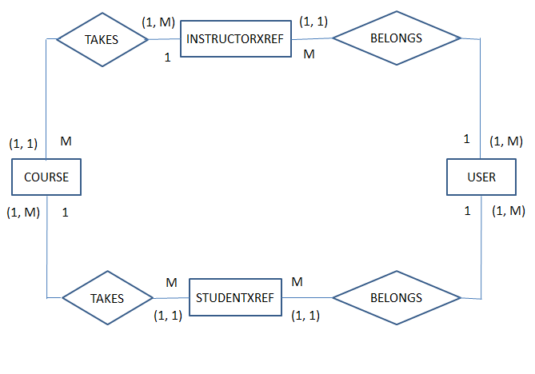
Fig 1: Entity relationship diagram for Online Learning Management System.

Slide 10
Create table statements:
CREATE TABLE USERDETAILS(
USER_ID INT(11) UNSIGNED NOT NULL AUTO_INCREMENT UNIQUE PRIMARY KEY,
USER_EMAIL VARCHAR(30) NOT NULL,
USER_PASSWORD VARCHAR(30) NOT NULL,
USER_NAME VARCHAR(30) NOT NULL,
USER_DOB DATE,
USER_ACCOUNTTYPE VARCHAR(30) NOT NULL);
CREATE TABLE COURSE(
COURSE_ID INT(11) UNSIGNED NOT NULL AUTO_INCREMENT UNIQUE PRIMARY KEY,
COURSE_NAME VARCHAR(30) NOT NULL UNIQUE,
COURSE_DEPT VARCHAR(50) NOT NULL,
COURSE_DESCRIPTION VARCHAR(500) NOT NULL,
COURSE_STARTDATE DATE NOT NULL,
COURSE_ENDDATE DATE NOT NULL
);

Slide 11
Sample Queries:
1. Show course name available for student to enroll:
SELECT DISTINCT COURSE_NAME
FROM COURSE
WHERE COURSE_ID NOT IN(SELECT COURSE_ID FROM STUDENTXREF WHERE USER_ID = 1)
AND COURSE_STARTDATE >= CURDATE()
AND COURSE_ENDDATE >= CURDATE();
2. Select user id from user table:
SELECT USER_ID FROM USER
WHERE USER_NAME = 2;
3. Courses which instructor can teach:
SELECT DISTINCT COURSE_NAME FROM COURSE
WHERE COURSE_ID NOT IN(SELECT DISTINCT COURSE_ID FROM INSTRUCTORXREF);

Slide 12

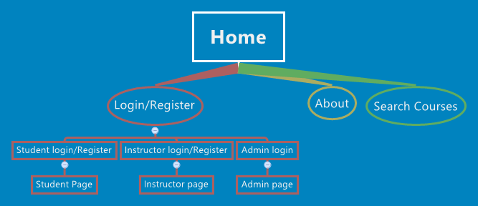
Sitemap for the website:

Slide 13
Website Demonstration:
Online Management Learning System

Slide 14
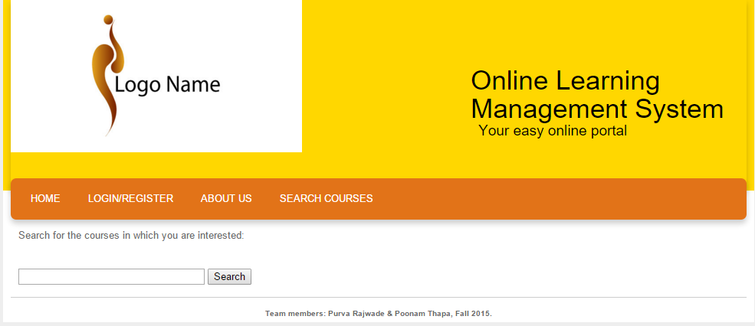
Major pages and screenshots:
Search page- provides functionality to search for available courses for enrollment:

Slide 15
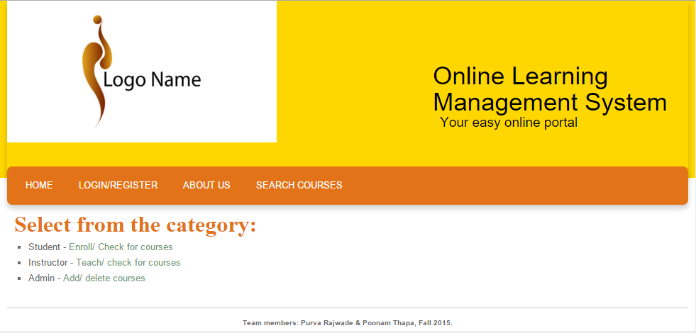
Major pages and screenshots:
Login/Register page- It is a way to create account and get more benefits based on user type:

Slide 16
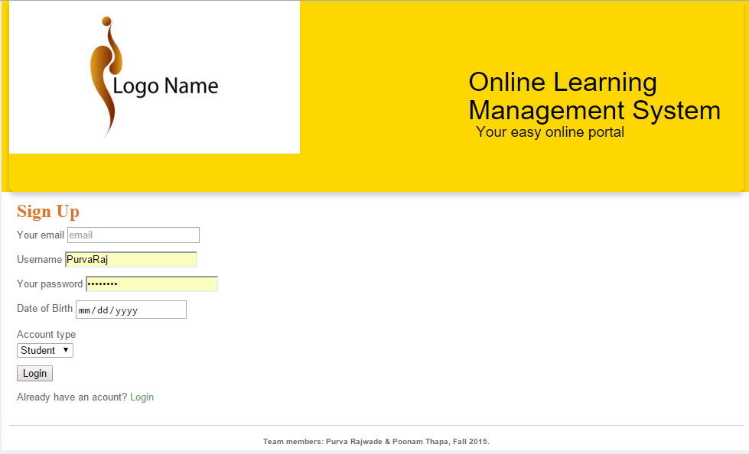
Major pages and screenshots:
Register page-

Slide 17
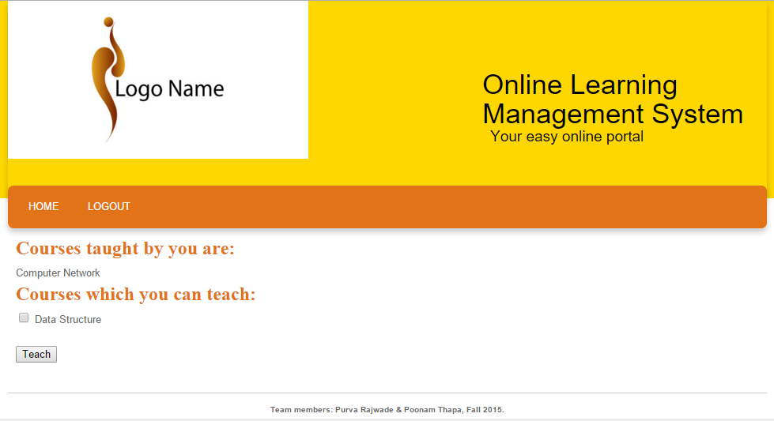
Major pages and screenshots:
Instructor page- This shows the courses already taught by particular user id and provide option to teach available courses:

Slide 18
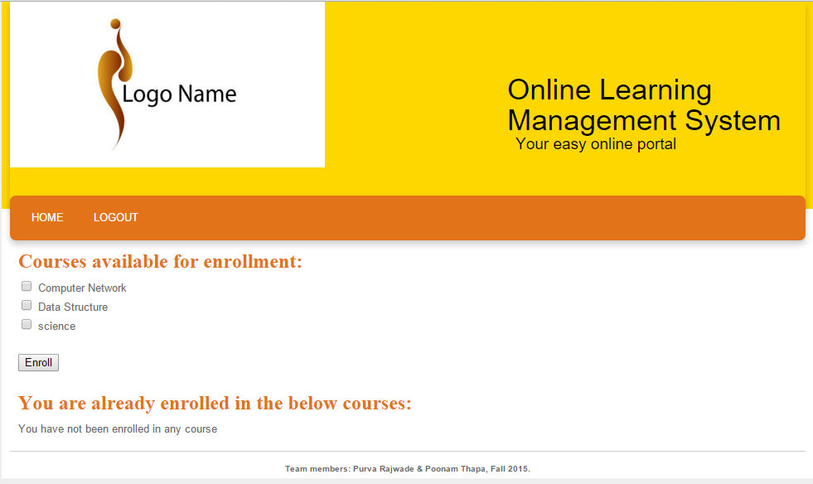
Major pages and screenshots:
Student page- After login, courses available for enrollment are displayed and the courses in which particular user id is enrolled:

Slide 19
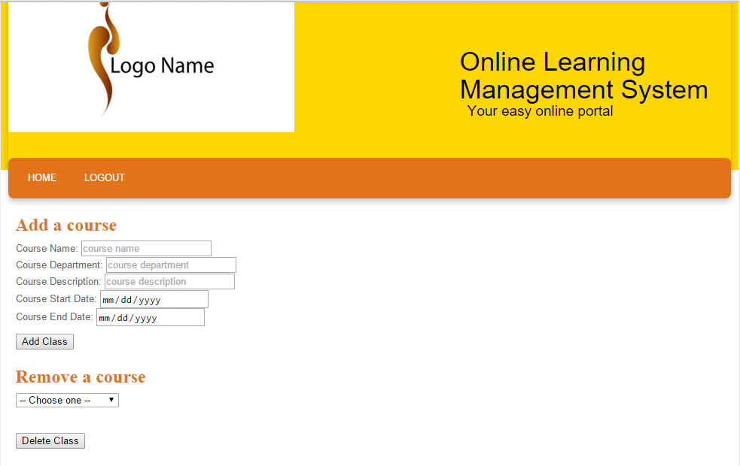
Major pages and screenshots:
Admin page- Admin is responsible to add or delete courses:

Slide 20
URL of the system:
The URL to visit the website is:
http://coolt-courses.lis.unt.edu/slis5717/Purva/trial2/HomePage.html
Students and instructor can create their own account.
Admin who is responsible for adding or deleting courses is:
Username – admin
Password - admin

Slide 21
What you have learned from this project?
From this project we learned how to create dynamic pages.
Came to know about including php code in html and vice versa.
Learned about creating session for a user and then handling it with the multiple pages.
This project gave us any idea how to connect to the database and how to connect multiple pages.

Slide 22
Future enhancements for the project are:
Based on the entries in database, graphs can be created to provide information about the number of students in each course.
Class entity can be added to provide more information about courses like class room, class timings, etc.
Change the template to make it more attractive and user friendly.
Passwords can be stored in an encrypted way to avoid giving away personal information.

